Slide 1
Cancer across species: Development of novel model organisms in cancer research
Michelle Culbertson
Arizona/NASA Space Grant Undergraduate Research Symposium
April 22, 2017

Slide 2
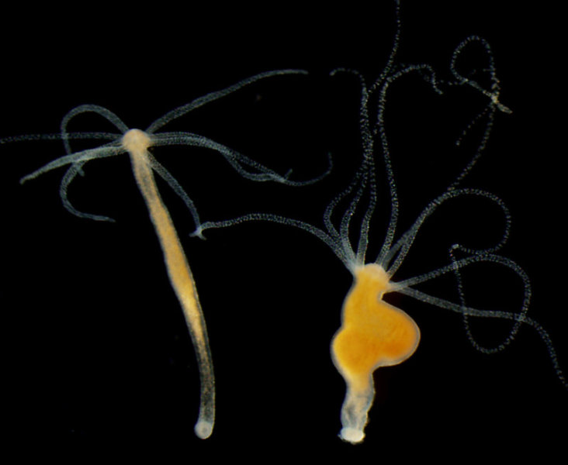
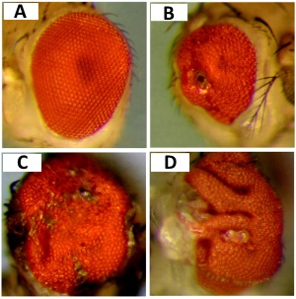
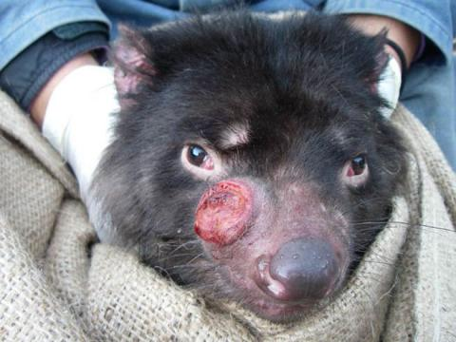
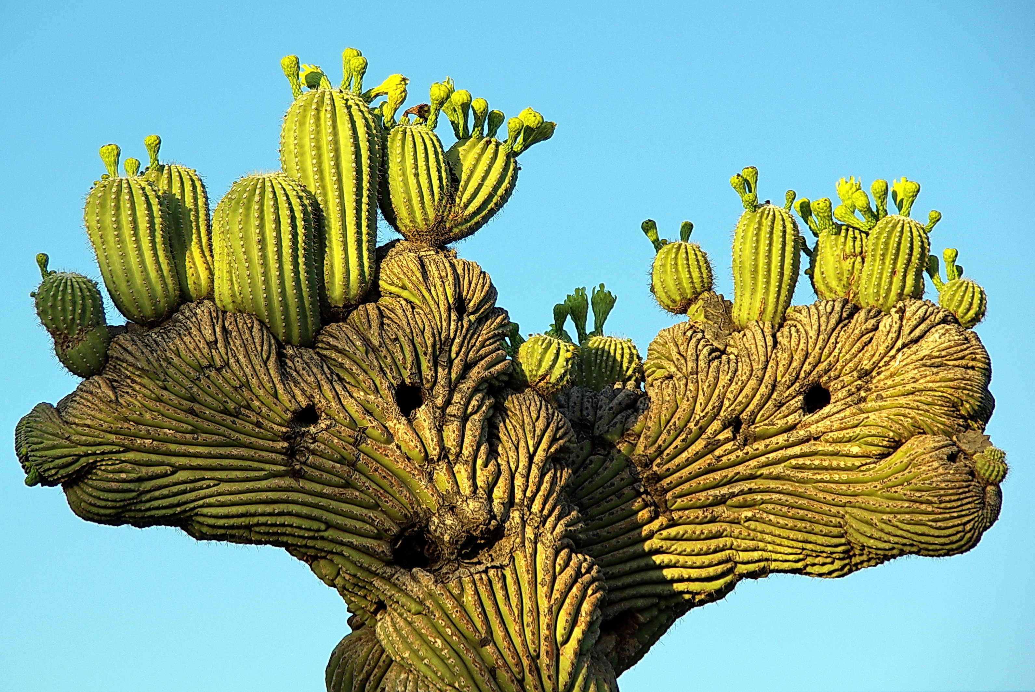
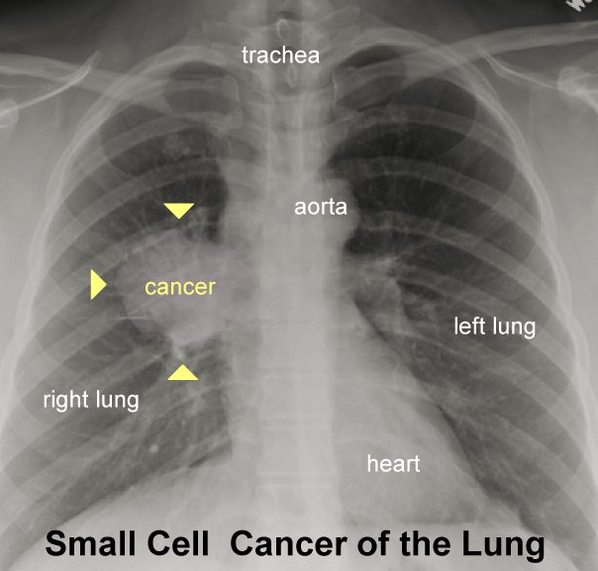
Cancer across species
Cancer-like

Slide 3
Evolution of cancer
Cancer develops from accumulated DNA mutations
Cancer is inherent to multicellular organisms
  But cancer is not seen in all of them
  Why?
What can we learn from new model organisms?
Objective: Study simple model organisms to identify if they get cancer, or how they can prevent it
Notes:
Expect to see cancer phenotype in these organisms but don’t

Slide 4
Methods
Select model organisms
Establish culturing methods
Create mutagenesis protocols
Observe phenotypic changes
Investigate molecular changes

Slide 5
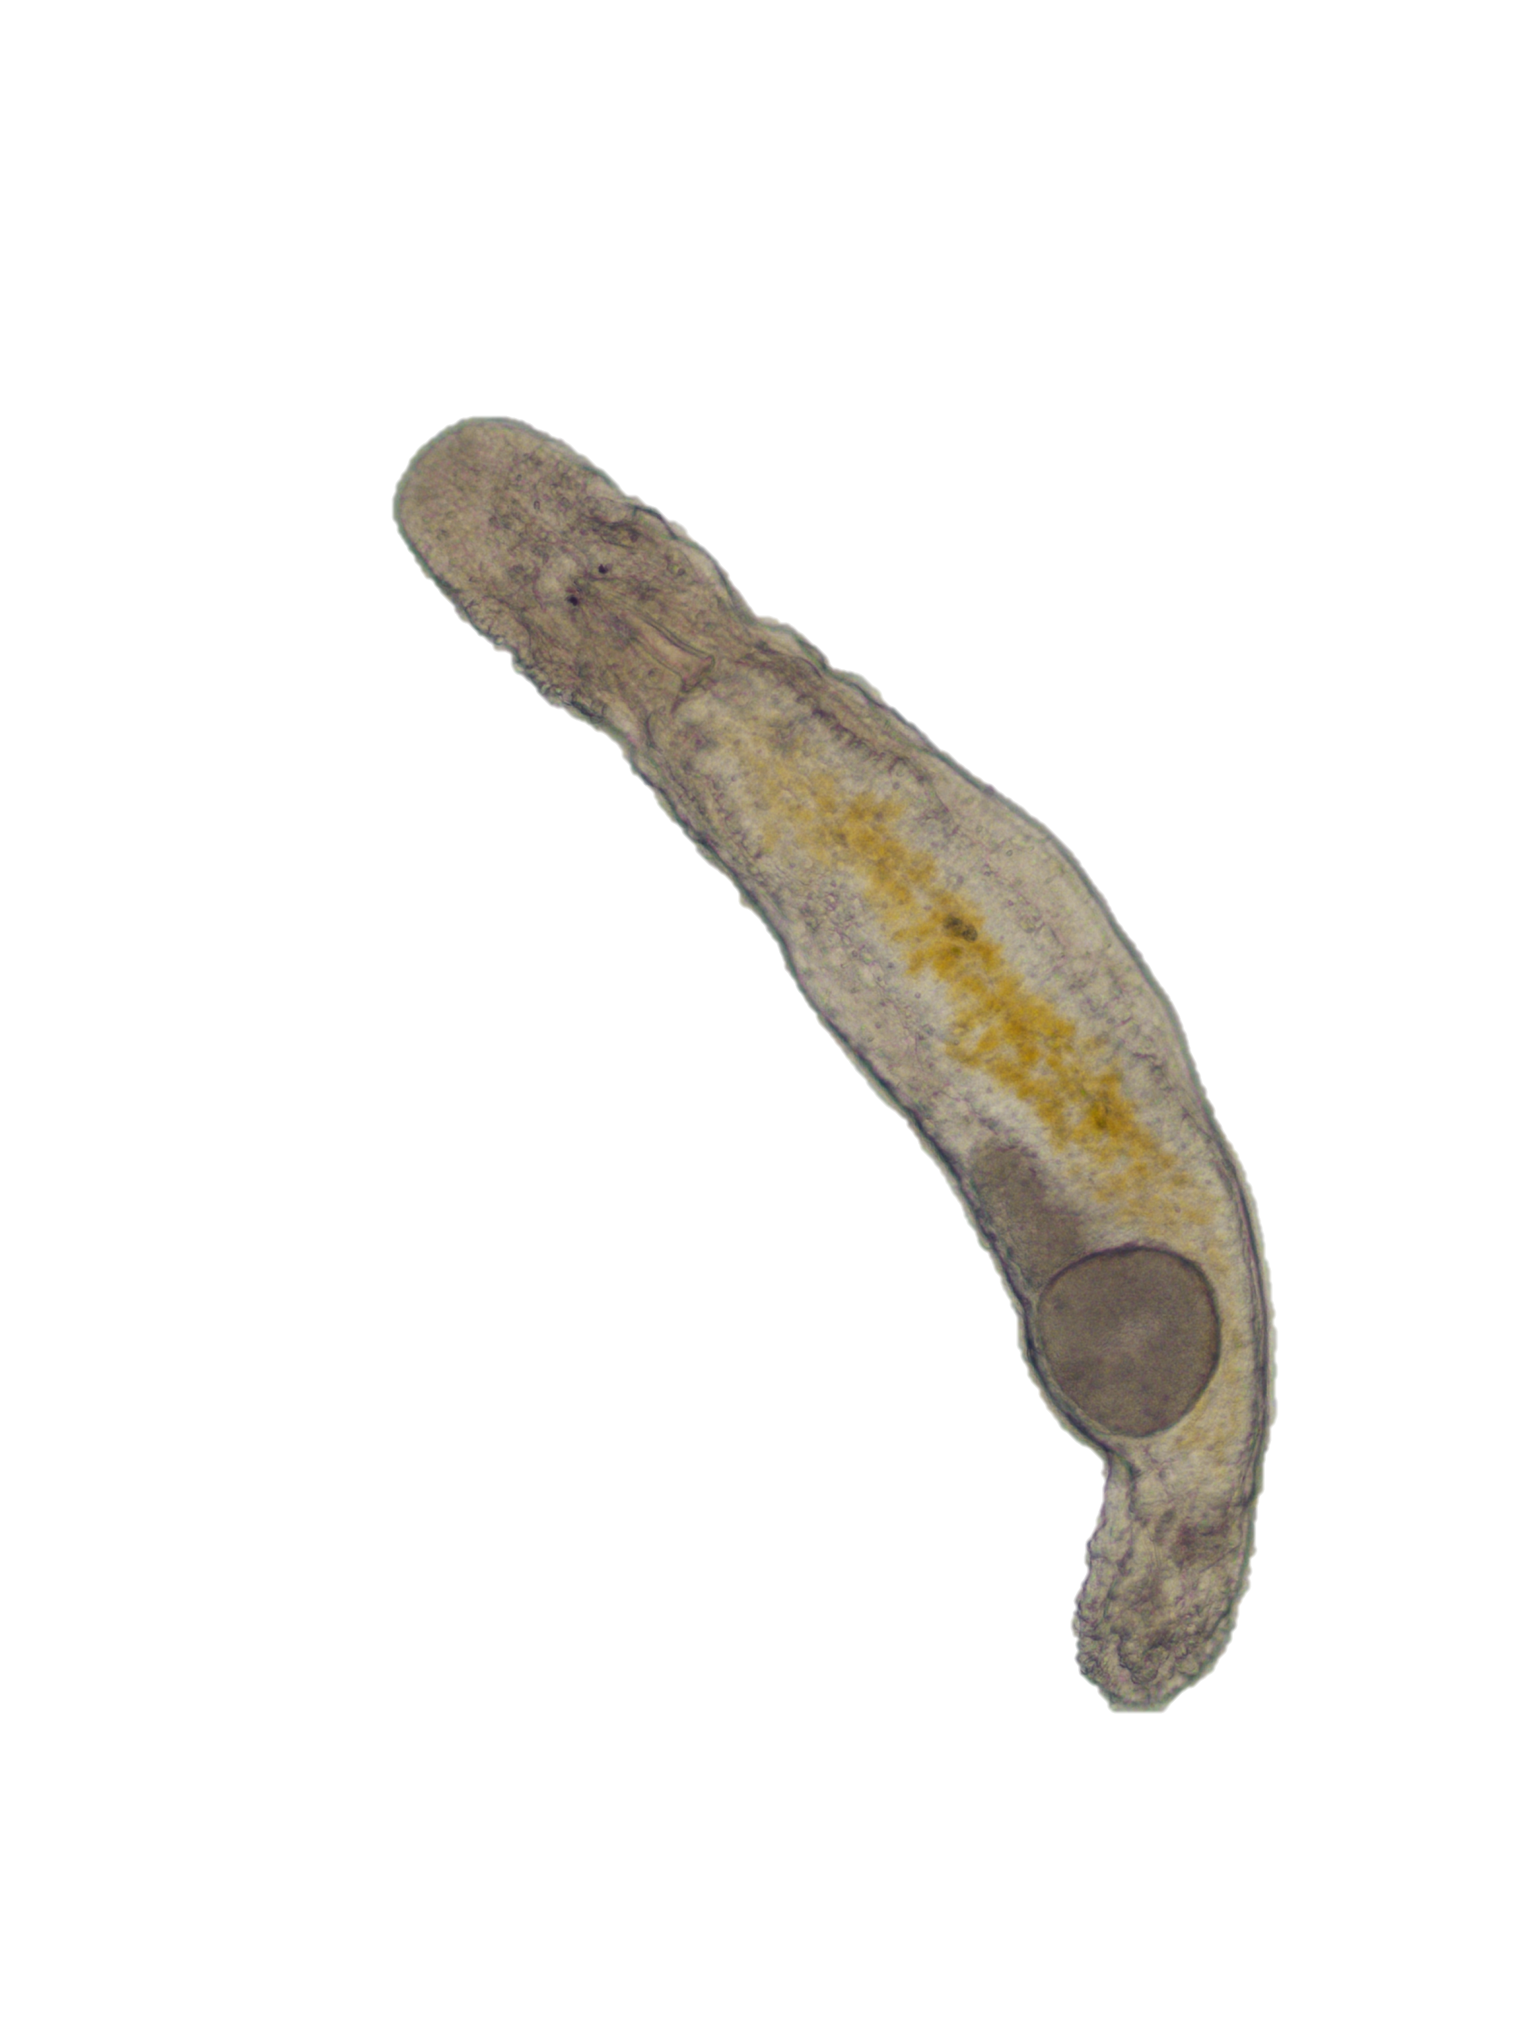
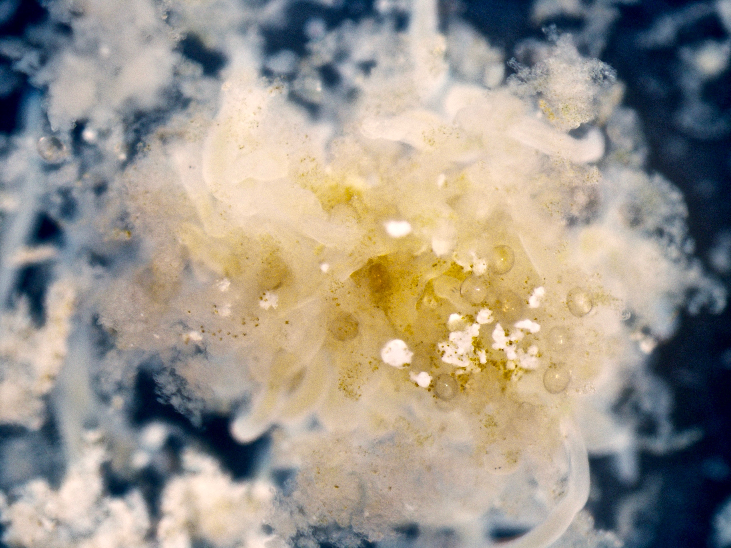
Macrostomum lignano
Free-living marine flatworm species
  Lifespan: 6-7 months, up to 2 years
  Powerful regenerative ability due to stem cells
  No cancer-like phenomena observed
Conserved genes and pathways with humans
Cultured in Petri dishes with Nitzschia curvilineata algae
Notes:
Mention we’re studying other organisms too
Check lifespan

Slide 6
Methods
Physical mutagenesis
Treatment 1 (6 × 5 Gy)
5 Gy
3 days
  Treatment 2 (3 × 10 Gy)
10 Gy
Chemical mutagenesis
50 mM ethyl methanesulfonate (EMS)

Slide 7
Current results
Dosage optimized to 30 Gy
  Minimal mortality
  Minimal effects on reproduction
Cancer-like phenotype seen in irradiated worms
Notes:
More treatments at low dose gives more opportunities for cells to acquire mutations
Unsure about chemical experiments
3 months after starting treatment

Slide 8
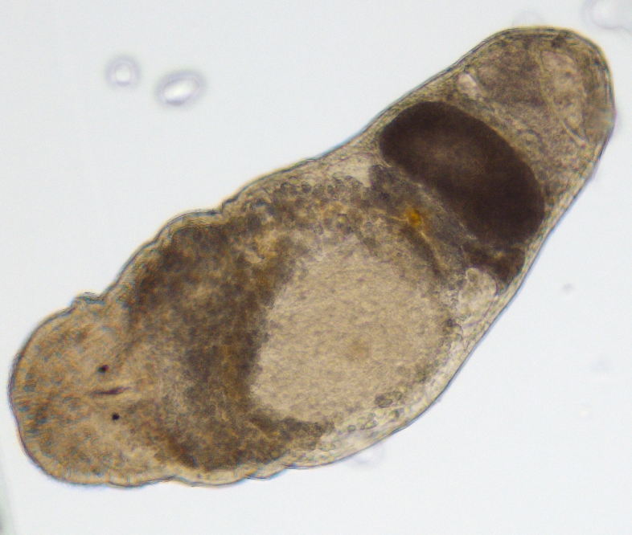
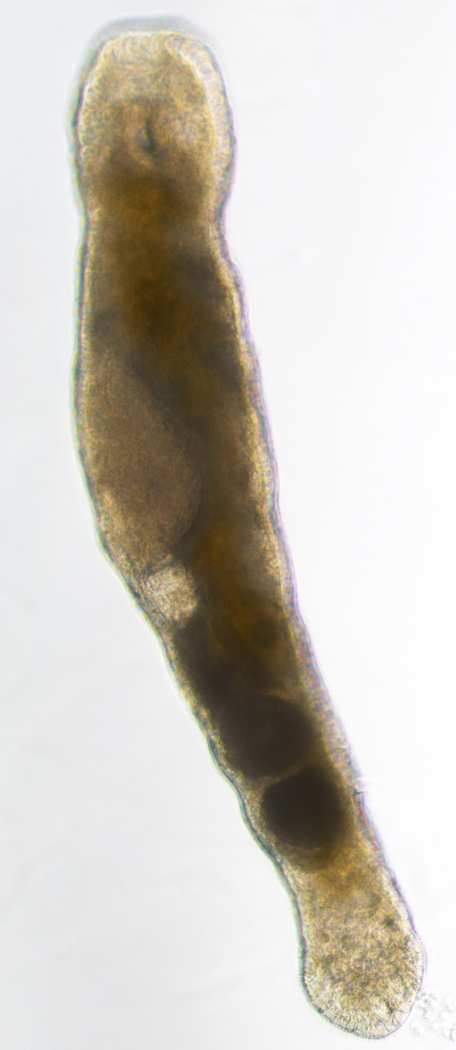
Current results
2 individuals from 6 × 5 Gy treatment with cancer-like phenotypes
  More phenotypes observed in 6 × 5 Gy than 3 × 10 Gy
Notes:
Unsure about chemical experiments
3 months after starting treatment

Slide 9
Current results
Dosage optimized to 30 Gy
  Minimal mortality
  Minimal effects on reproduction
Cancer-like phenotype seen in irradiated worms
  Possibly originating in the gonads
  Masses appear to grow over time
  Observed ~3 months after first treatment
  Preliminary data suggests higher mortality in 6 × 5 Gy
No new phenotypes seen yet after chemical treatment
Notes:
More treatments at low dose gives more opportunities for cells to acquire mutations
Unsure about chemical experiments
3 months after starting treatment

Slide 10
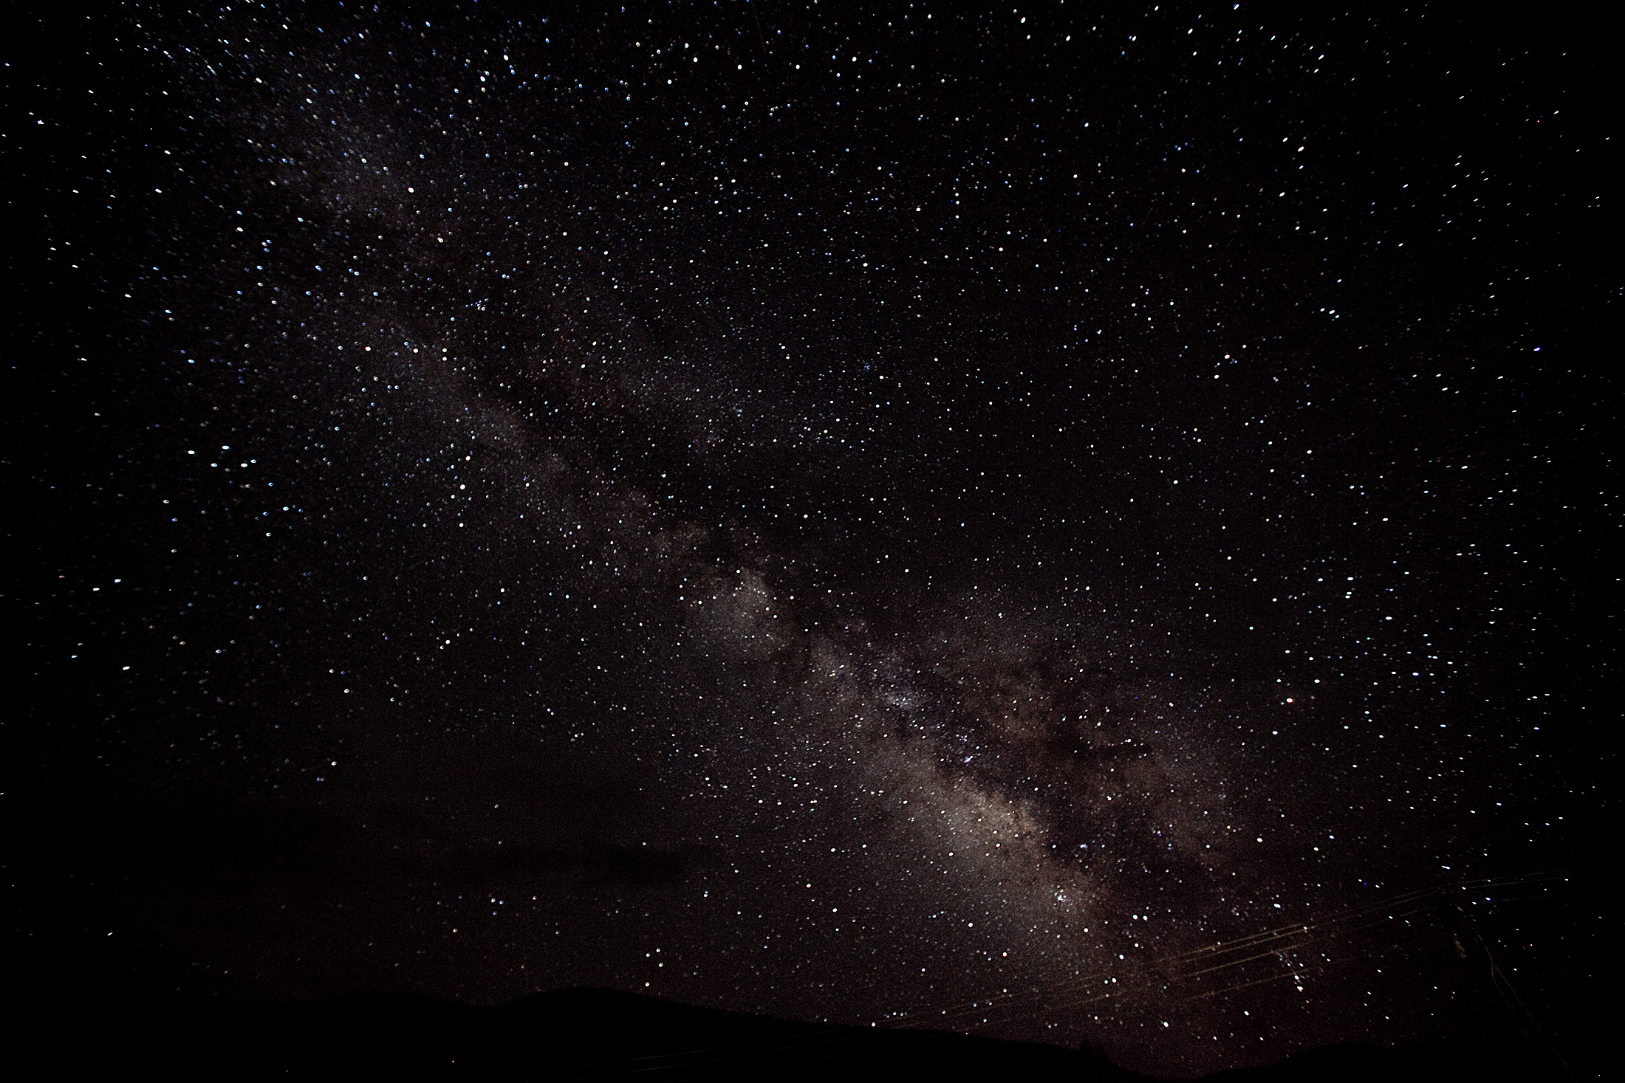
Future goals
Further analysis of tumor-like phenotype
  Histological analysis of tumor-like phenotype to confirm cancer growth
  Gene and protein expression, specifically for conserved pathways
Test other mutagenesis methods
Continue studying other model organisms
  Trichoplax adhaerans
  Tethya wilhelma

Slide 11


Acknowledgements
Maley lab members
ASU/NASA Space Grant
Arizona/NASA Space Grant

Slide 12
Any questions?

Slide 14
References
Photo credits
  Tasmanian Devils evolving resistance to facial cancer. 2016. https://www.greenleft.org.au/content/tasmanian-devils-evolving-resistance-facial-cancer
  Alan English. 2015. https://www.flickr.com/photos/alanenglish/4540101760/
  Domazet-Lošo T, Klimovich A, Anokhin B, Anton-Erxleben F, Hamm MJ, Lange C, Bosch TC. Naturally occurring tumours in the basal metazoan Hydra. Nature communications. 2014 Jun 24;5.
  Lung Cancer Images. http://www.aboutcancer.com/lung_xrays_abnormal.htm
  Uhlirova M, Jasper H, Bohmann D. Non-cell-autonomous induction of tissue overgrowth by JNK/Ras cooperation in a Drosophila tumor model. Proceedings of the National Academy of Sciences of the United States of America. 2005 Sep 13;102(37):13123-8.
  Griffiths, A.J.F.; Wessler, R.C. and Carroll, S. (2008). Introduction to Genetic Analysis. W H Freeman & Co.
  Effects of Ionizing Radiation on DNA. Teach Nuclear. http://teachnuclear.ca/all-things-nuclear/radiation/biological-effects-of-radiation/effects-of-ionizing-radiation-on-dna/
Aktipis, C. A., Boddy, A. M., Jansen, G., Hibner, U., Hochberg, M. E., Maley, C. C., & Wilkinson, G. S. (2015). Cancer across the tree of life: cooperation and cheating in multicellularity. Philosophical Transactions of the Royal Society B: Biological Sciences, 370(1673), 20140219–20140219.
Mouton, S., Willems, M., Braeckman, B. P., Egger, B., Ladurner, P., Schärer, L., & Borgonie, G. (2009). The free-living flatworm Macrostomum lignano: A new model organism for ageing research. Experimental Gerontology, 44(4), 243–249.

Slide 15
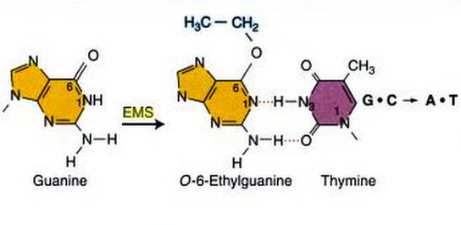
Mutagenesis methods

Slide 16
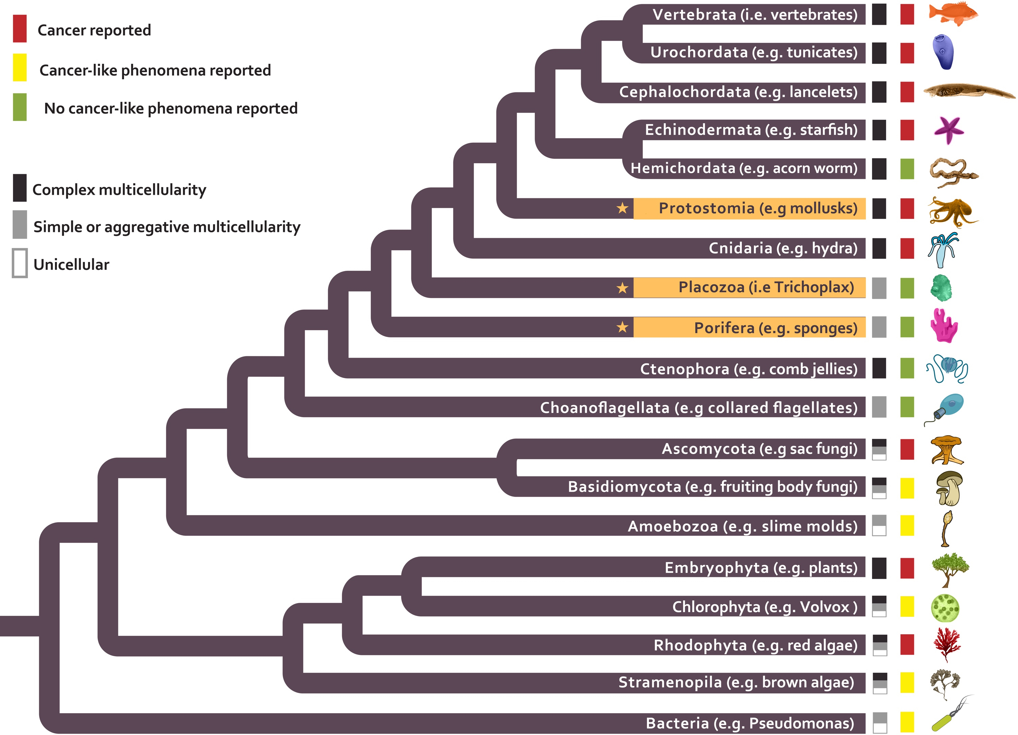
Cancer across life

Slide 17
Culturing conditions
Organism | Media | Temp (˚C) | Food | System
M. lignano | f/2 | 23 | Nitzschia curvilineata | Petri dishes
T. adhaerans | ASW | 23-25 | Pyrenomonas helgolandii | Aquarium and plates
T. wilhelma | ASW | 23-25 | Artificial plankton (Aquakultur-Genzel) | Aquarium with ecological environment
Artificial seawater (ASW): 32.5% salinity (by weight)
f/2: ASW with vitamins, trace metals, and extra salts

Slide 18
Sponge culturing system
Filter tank
Ecological habitat
Culturing tank

